Slide 1
AZURE CLOUD PLATFORM · INDUSTRIAL INTERNSHIP PROJECT
Azure Cloud-Based Document
Management System
Secure Cloud Storage with Automated Version Control and Audit Logging, built on Microsoft Azure
Python
Flask
Azure App Service
Azure SQL Database
Azure Blob Storage
GitHub Actions
Presented By Dhanush S J
Integrated M.Tech Software Engineering · VIT
01

Slide 2
PROJECT OVERVIEW
Introduction
Modern organizations manage thousands of digital documents daily. Traditional local storage suffers from data loss, weak version tracking, poor accessibility, and inadequate security. Microsoft Azure offers enterprise-grade, scalable cloud services that simplify deployment, secure storage, and centralized management.
☁
Cloud-Native
Hosted entirely on Azure App Service
↻
Version Controlled
This project delivers a cloud-based Document Management System built with Flask and Microsoft Azure — allowing users to upload, manage, download, version, and restore documents, with application data secured in Azure SQL Database and files stored in Azure Blob Storage.
Automatic versioning on every upload
✓
Fully Audited
Every action logged for accountability
02

Slide 3
WHY THIS PROJECT
Problem Statement
Traditional document management systems carry significant, well-known drawbacks:
×
Documents stored locally are vulnerable to system failures
×
Lack of audit tracking for document activities
×
No centralized document repository
×
Poor scalability for multiple concurrent users
×
Limited support for version management
×
Manual, error-prone backup processes
×
Difficulty restoring previous document versions
×
Security risks inherent to local storage
A cloud-based system providing secure storage, automated versioning, audit logging, and centralized access is essential.
03

Slide 4
GOALS & SCOPE
Project Objectives
01
02
03
Develop a secure document management system
Store application data in Azure SQL Database
Store uploaded files in Azure Blob Storage
04
05
06
Implement automatic document versioning
Enable restoration of previous versions
Maintain audit logs for all user activities
07
08
09
Deploy the application via Azure App Service
Automate deployment using GitHub Actions
Provide centralized access from any device
04

Slide 5
WHAT IT'S BUILT WITH
Technology Stack
●
●
●
LANGUAGE
BACKEND FRAMEWORK
ORM
Python
Flask
SQLAlchemy
●
●
●
DATABASE
CLOUD STORAGE
AUTHENTICATION
Azure SQL Database
Azure Blob Storage
Flask-Login, Flask-Bcrypt
●
●
●
MIGRATIONS
DEPLOYMENT
VERSION CONTROL
Flask-Migrate, Alembic
Azure App Service
Git, GitHub, GitHub Actions
05

Slide 6
CLOUD INFRASTRUCTURE
Microsoft Azure Services
⚙
⌸
▣
Azure App Service
Azure SQL Database
Azure Blob Storage
Hosts and runs the Flask web application in the cloud
Stores users, documents, versions, and audit logs
Securely stores every uploaded file
↻
⇄
⌥
Blob Versioning
Deployment Center
GitHub Actions
Auto-creates a new version on re-upload of a filename
Automates deployment directly from GitHub
Builds and deploys the project on every push
06

Slide 7
HOW DATA MOVES
Overall Workflow
☉
▢
⌸
▣
↓
User
Flask Application
Azure SQL + Blob
Dashboard Update
Download / Restore
Interacts via browser
Handles logic & requests
Stores data & files
Reflects live metrics
User retrieves files
Every upload flows through Flask, splitting metadata into Azure SQL Database and the file itself into Azure Blob Storage — keeping the dashboard and audit trail always in sync.
07

Slide 8
LAYERED DESIGN
System Architecture
User
Browser-based access
Azure App Service — Flask Application
Application logic, authentication & routing
⌸
Azure SQL Database
▣
Azure Blob Storage
Users · Documents · Versions · Audits
Versioned file storage, all uploads
Dashboard & Audit Logs
Real-time metrics and full activity trail for every user
08

Slide 9
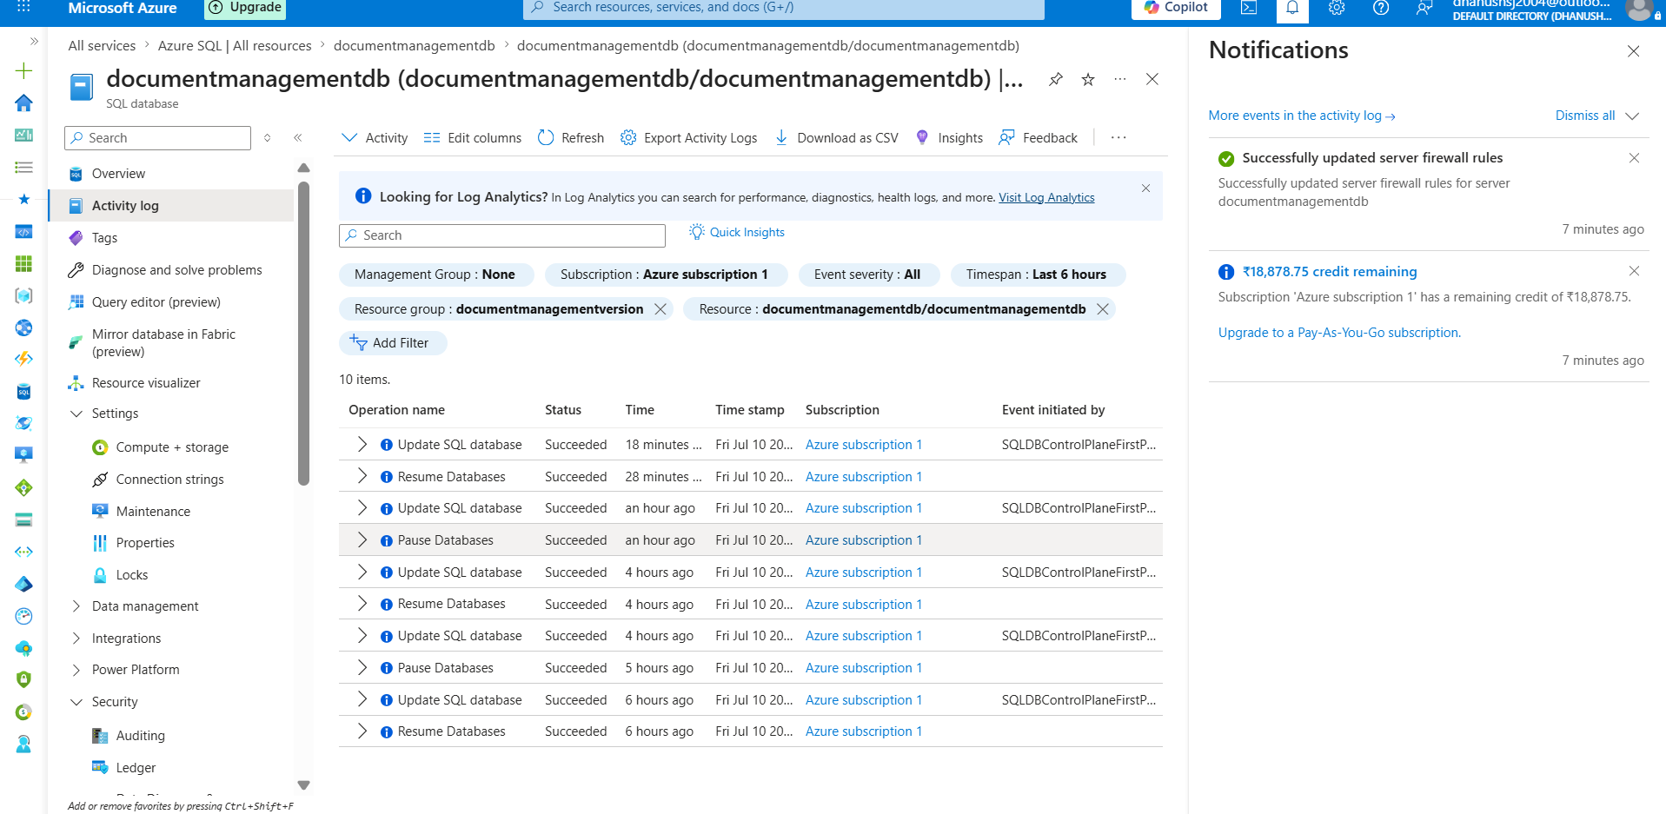
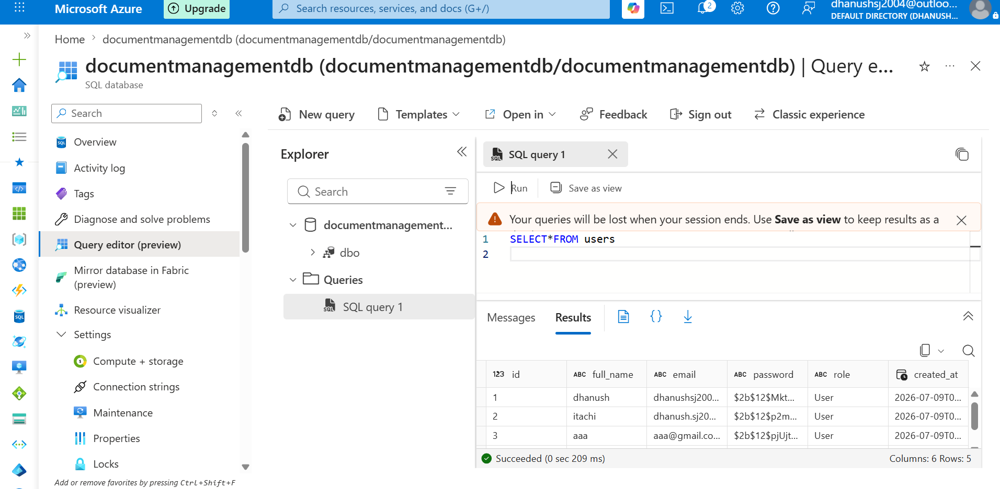
AZURE SQL SCHEMA
Database Design
Users
Documents
Versions
Audits
User Name
Document Title
Version Number
User
Email
Owner
Azure Version ID
Action
Password
Latest Version
File URL
Timestamp
Role
Upload Time
Document Name
Azure SQL Database stores all structured metadata, while Azure Blob Storage holds the actual document files — linked through Version records.
Live activity log confirms the database scales automatically under application load.
09

Slide 10
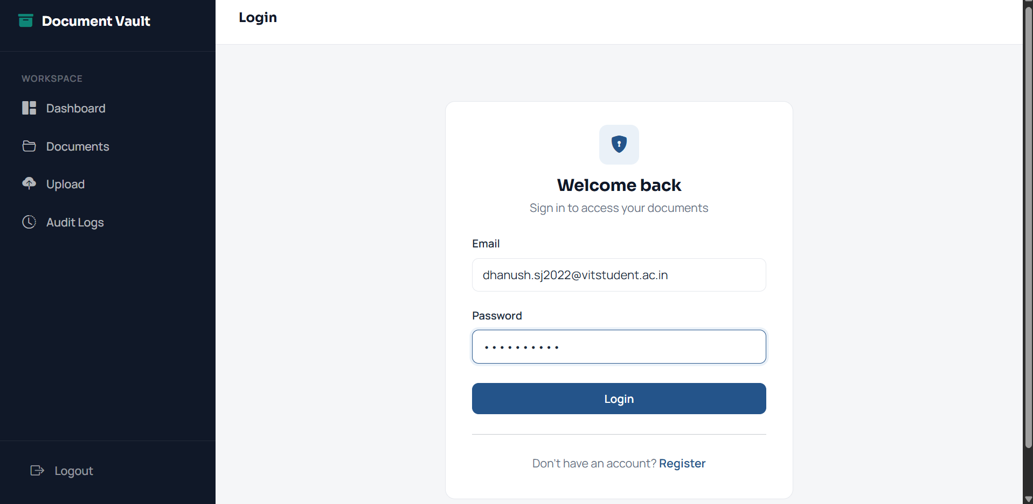
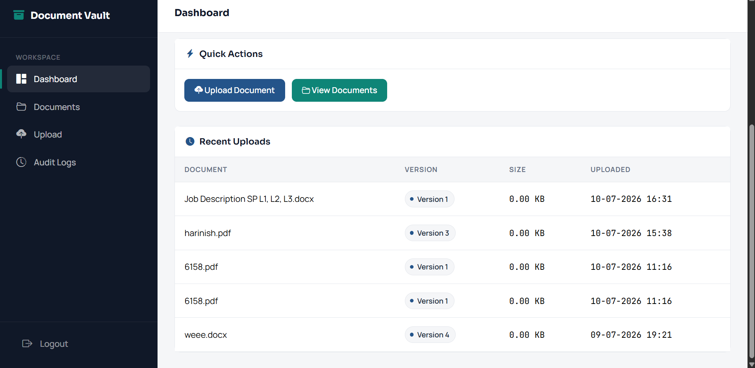
WHAT USERS CAN DO
Project Features
1
Authentication
Register, log in, and log out securely
2
Dashboard
Live totals: documents, versions, users, storage
3
Document Management
Upload, download, and delete files
4
Version Control
Automatic versioning with one-click restore
Secure Login
5
Audit Logs
Every upload, download, restore & delete tracked
10
Live Dashboard

Slide 11
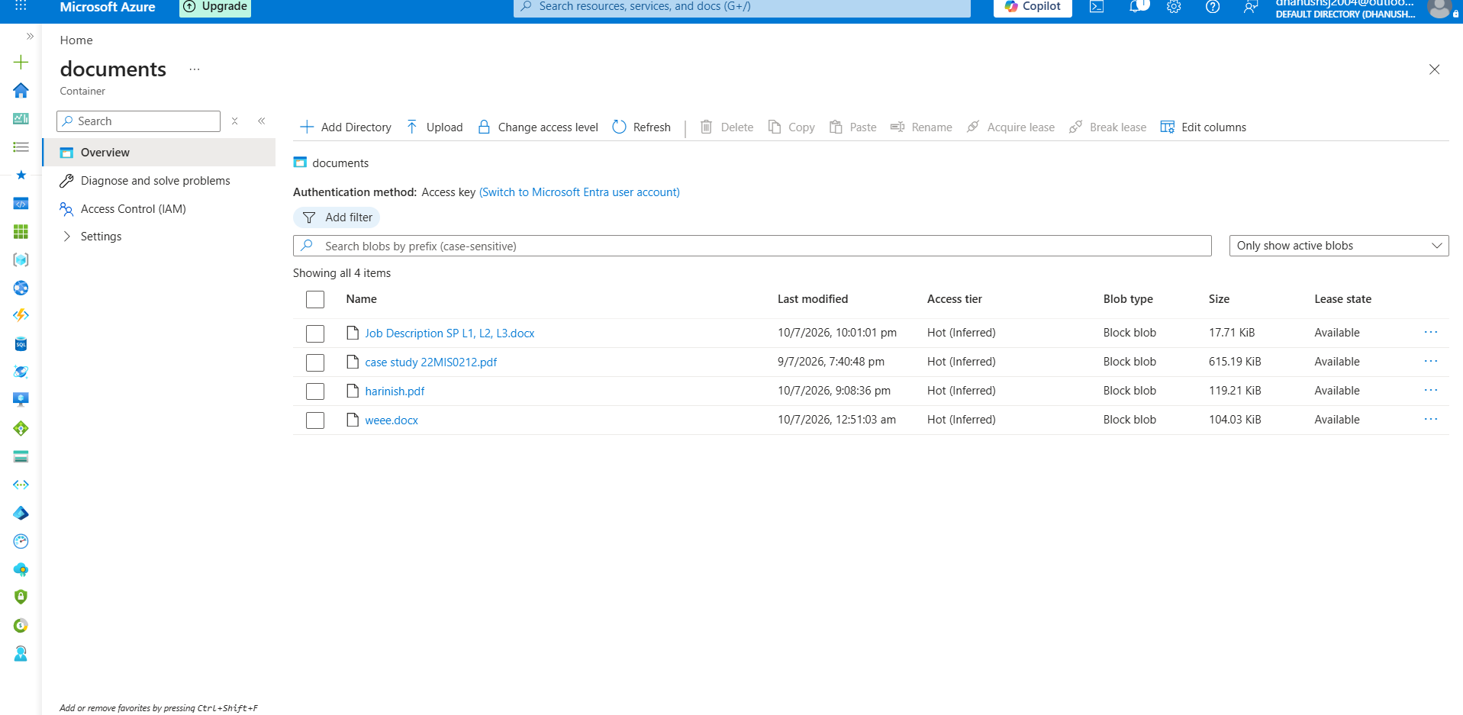
FILE UPLOAD PIPELINE
Azure Blob Storage Integration
1
Flask receives the uploaded file
2
File is streamed to Azure Blob Storage
3
A unique Blob URL is generated
4
Azure assigns a new Version ID
5
Blob URL & Version ID are saved to Azure SQL
Azure Blob Storage — container view of uploaded documents
Secure Storage
High Availability
Automatic Versioning
Elastic Scalability
11

Slide 12
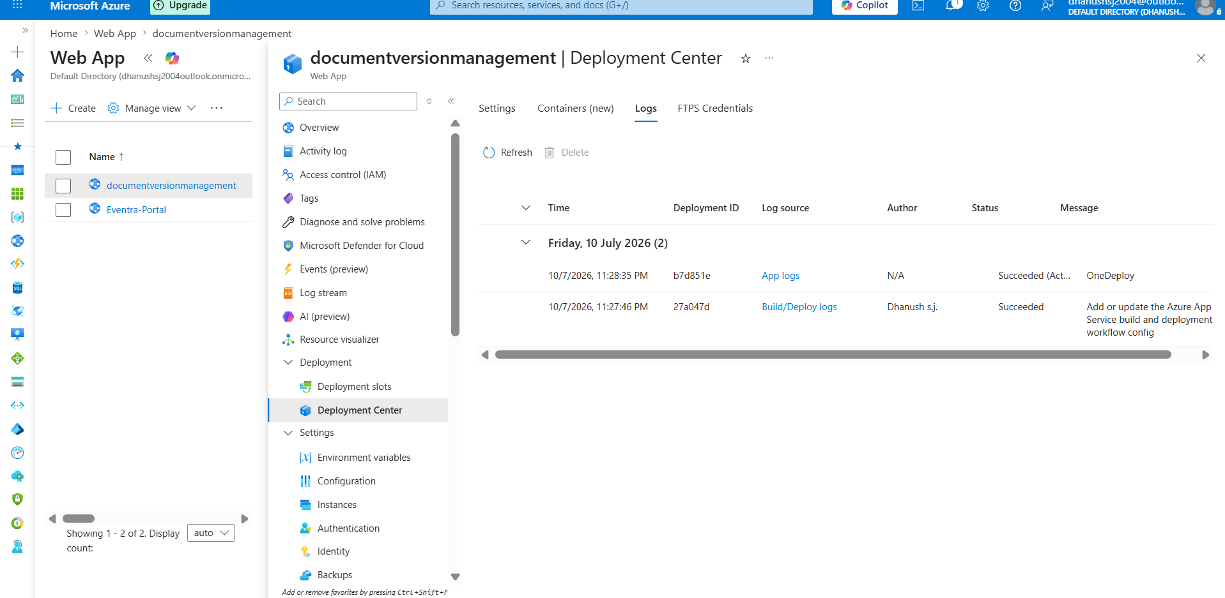
CI/CD PIPELINE
Cloud Deployment Workflow
⌘
⌥
⚙
⇄
☁
✓
Developer
GitHub Repo
GitHub Actions
Deployment Center
App Service
Live Website
Pushes code
Version controlled
Builds automatically
Connects to Azure
Deploys the build
Publicly available
12

Slide 13
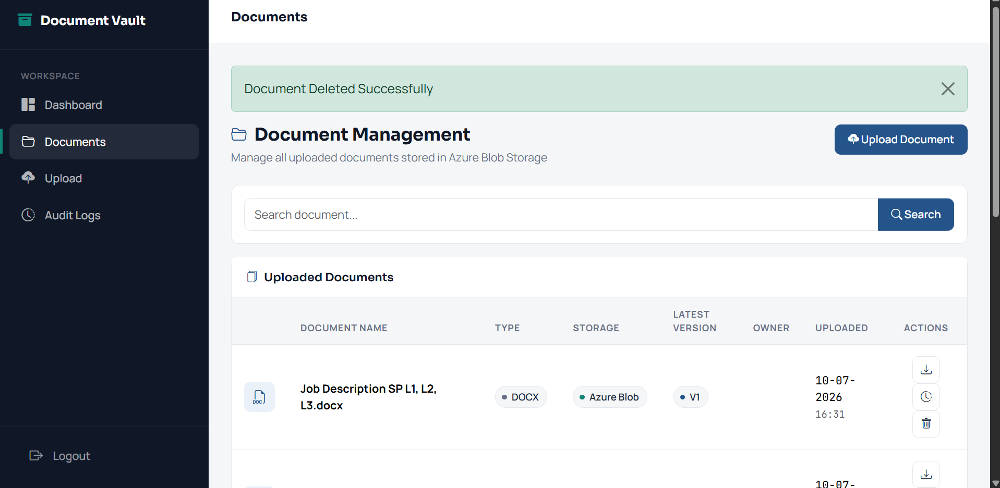
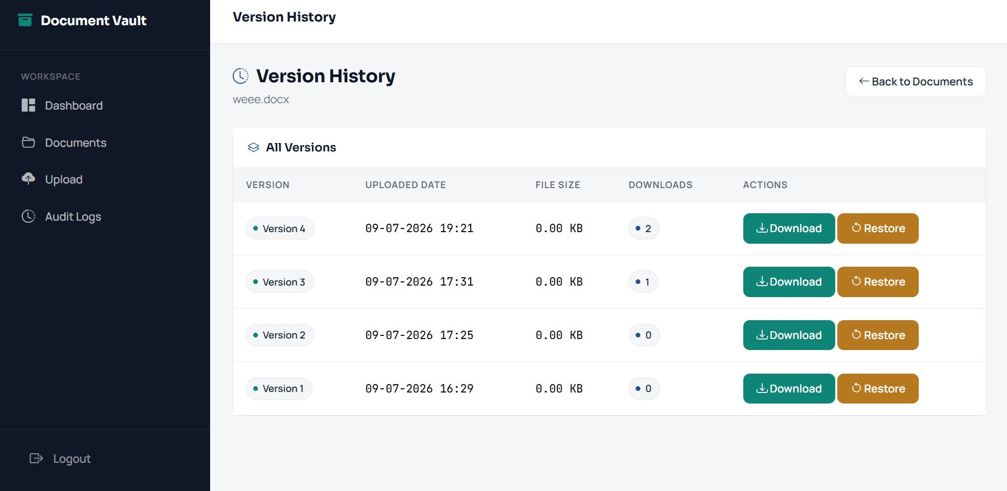
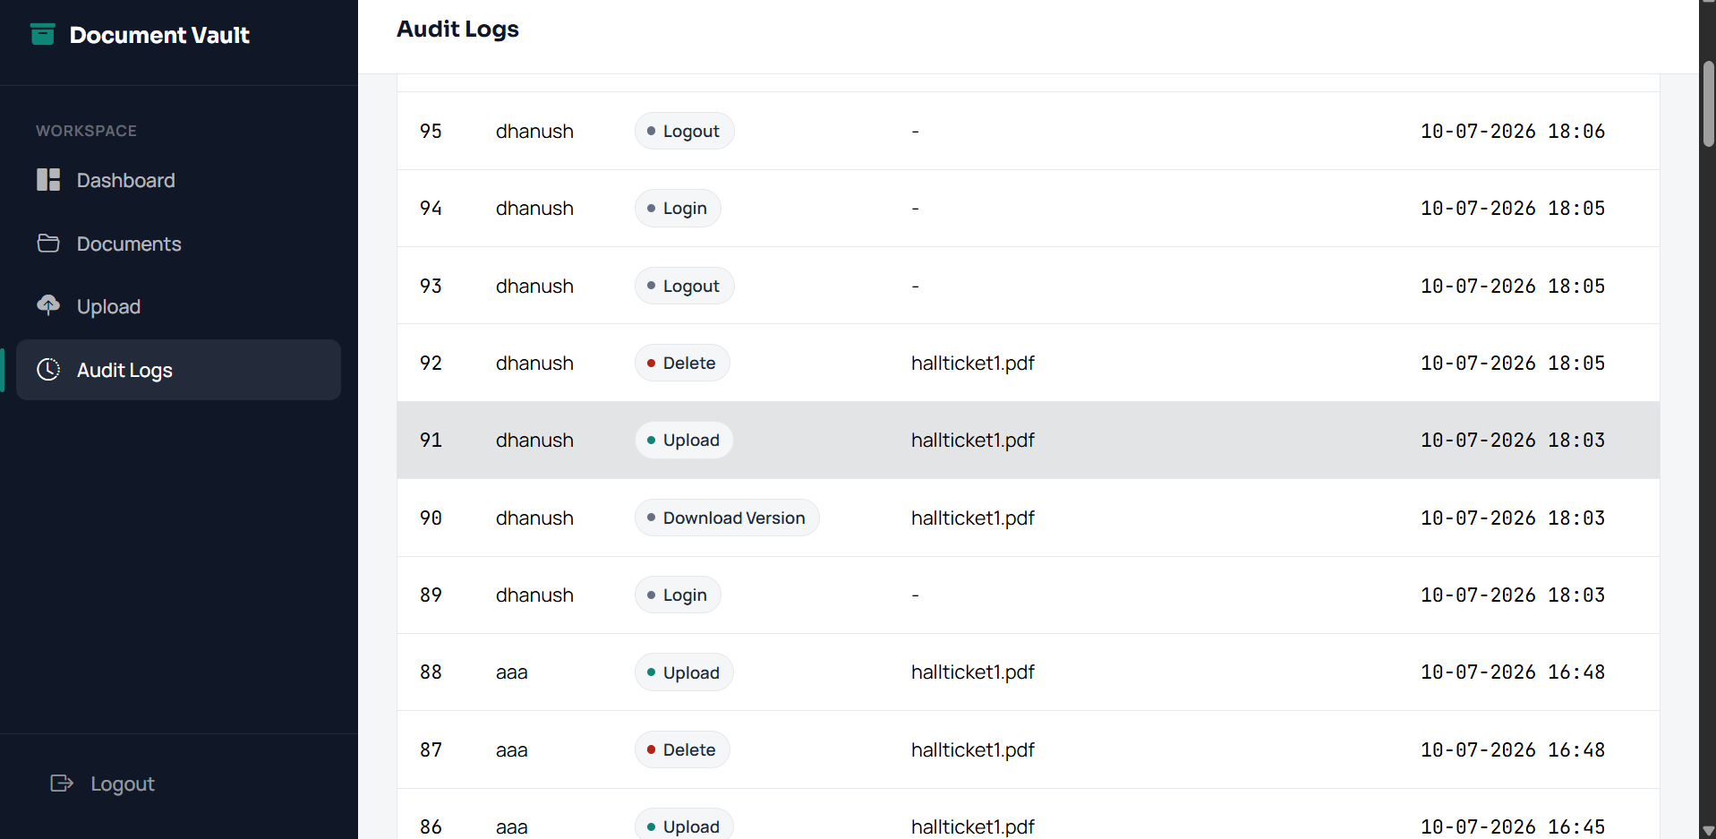
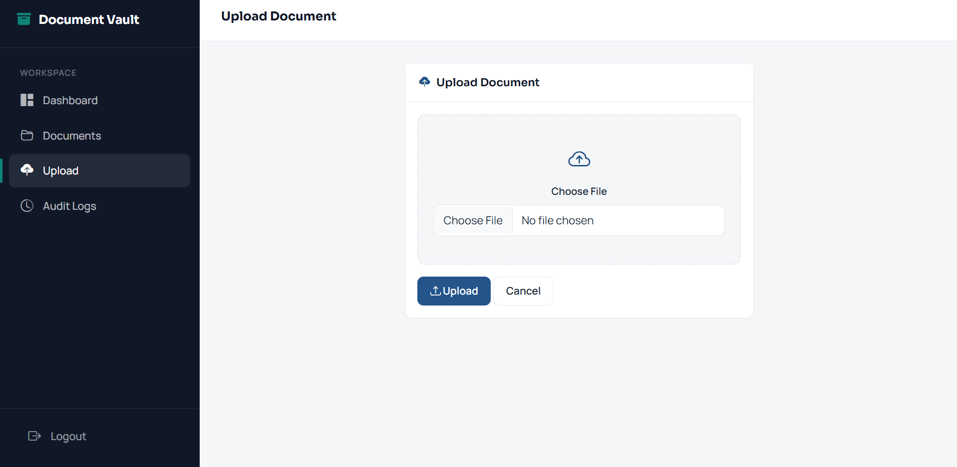
DELIVERED & VERIFIED
Results Achieved
✓
User Authentication
✓
Version Management
✓
Azure SQL Database
✓
Restore Previous Version
✓
Azure Blob Storage
✓
Audit Logging
✓
Document Upload
✓
Azure Deployment
Document Management
Version History
✓
Document Download
✓
GitHub Actions CI/CD
Application successfully hosted live on Azure App Service.
Audit Logs
Upload Interface
13

Slide 14
WHAT'S NEXT
Future Scope
⚑
⚙
⌕
⇄
✉
Role-Based Access Control
AI Document Classification
OCR for Scanned Documents
Document Sharing
Email Notifications
⌗
⚿
⌕
☢
↔
Storage Analytics
Multi-Factor Authentication
Azure AI Search
Document Encryption
Real-Time Collaboration
14

Slide 15
CONCLUSION
A Complete, Production-Ready
Cloud Document System
This project demonstrates the successful design, development, and deployment of a cloud-based Document Management System on Microsoft Azure. User data is secured in Azure SQL Database while files are stored in Azure Blob Storage with automatic versioning. Continuous deployment through Azure App Service and GitHub Actions keeps the application always up to date.
Secure Authentication
Cloud Storage
Version Management
Audit Logging
Scalable Deployment
Thank You
Dhanush S J · Integrated M.Tech Software Engineering · VIT
15

